Slide 1

Technology risk prevention and control in Digital Bank
eric.zhang@shopee.com

Slide 2
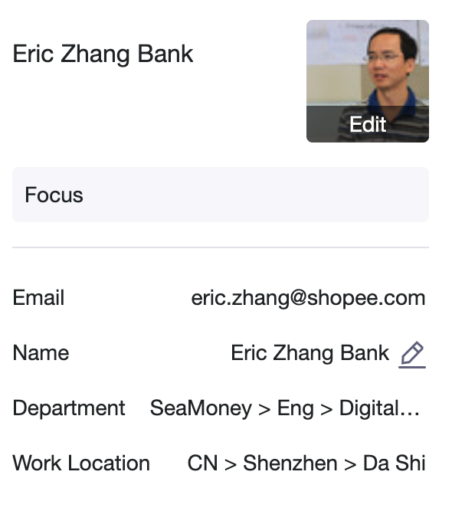




Self Introduction

Slide 3
Agenda
Technology Risk Background and Objectives
Technology risk background
Technology risk prevent and control objectives
Data consistency risk prevention and control
Cross database consistency risk(跨库一致性风险)
Cross system consistency risk(跨系统一致性风险)
Cross datacenter consistency risk(跨机房一致性风险)
Business continuity risk prevention and control
Daily development and operational risk
DR Switching Risk
Q&A

Slide 4
Technology Risk Background and Objectives

Slide 5
技术风险背景
近期，金融信息系统频繁出现中断，技术风险防控的重要性凸显。
2023.11
DBS(星展银行)
技术风险定义：
新加坡金管局强制实施 六个月暂停 星展银行的非必要活动（2023 年星展银行银行服务的 5 项严重中断）
Any adverse situation caused by the use of computer hardware, software, and networks（计算机硬件、软件、网络所引发的不利情况）, including program errors, system downtime, software defects, operating errors, hardware failures, insufficient capacity, network vulnerabilities, etc. [Worldwide standards for banking]
2023.03
Shopee Indonesia Bank
Shopee Indonesia Bank core database hardware failure, the app cannot be logged in, and portal/payment services are unavailable,the incident lasted for 0.5 hours;
技术风险特征：
隐藏性（隐蔽性）。技术风险就像病毒一样，长期潜伏在人体内。一般情况下，不会影响日常运营。但随着内外部环境的发展变化，如果不采取风险缓释措施，可能会发展成为风险事件。
突然性（突发性）。技术风险事件往往伴随着自然环境的变化或人为主观失误而发生，如地震、火灾、网络攻击等，具有随机性，难以预测。一旦发生，它们可能会失控并迅速蔓延。
惨重（灾难性）。一些全球重大科技风险事件往往会造成服务中断、财务损失、客户流失，甚至可能导致机构倒闭等严重后果。
2021.11
DBS(星展银行)
DBS Bank's online banking service was down due to daily service upgrades and thousands of customers complained; the service was interrupted for nearly 48 hours
2019.08
CCB(建设银行)
China Construction Bank's mobile banking is out of order, and inter-bank transfer transactions cannot be credited in real time; the outage lasts for 1.5 hours
HSBC(汇丰银行)
技术风险防控目标：
2016.01
HSBC's online banking failed and 17 million personal and business accounts were unable to log in normally for 9 hours
Data security（数据安全性）。That is to ensure the confidentiality, integrity and availability of data. In layman’s terms, data “cannot be lost”(数据“不能丢”)
Business continuity（业务连续性）。That is to ensure that the information system can provide services stably and continuously. In layman's terms, the system "cannot be interrupted" (系统“不能断”)
2015.12
Ant Group(蚂蚁集团)
Ant Financial system malfunctioned, Yu’e Bao earnings were repeatedly distributed, and the financial loss was more than 100 million.
5

Slide 6
Analysis of technical risks in different stages of Digital Bank
opening stage(开业期)
rapid development stage(快速发展期)
stable stage(稳定期)
● 代码中使用的中间件客户端版本多样，依赖冲突；使用有问题的客户端；配置不合理；
● 缺乏灰色能力；服务关闭和释放；
● 缺乏监控能力；接口耗时、接口成功率等服务接口监控数据缺失，难以定位问题；
Data consistency issues between systems lead to financial losses;
The business is growing rapidly, the number of systems has increased by one times compared to the opening of the bank, and the risk of DR switching has increased;
Improper service dependence; for example, lower-layer services depend on upper-layer services;
Data storage capacity risk (mysql/ceph/es)
Risk culture(建立风险文化，风险前置)
Risk handling efficiency (通过平台工具或算法,提升问题识别/处理的效率）

Slide 7
Digital Bank technology risk prevention and control objectives
Based on the problems encountered at different stages of Digital Bank development and the priority of each technical risk treatment, combined with the CAP principle of distributed systems, we set ourselves the following objectives(根据数字银行发展的不同阶段遇到的问题及各个技术风险处理的优先级，结合CAP原理，我们给自己设定如下目标):
Technical risk prevention and control objectives (技术风险防控目标) | import and urgent (重要且紧急) | import and not urgent (重要不紧急)
Data consistency risk (数据一致性风险) | cross database consistency risk(跨库数据一致性风险) The business system database is split, and the same transaction may across different databases. Using technical means to ensure cross database consistency and prevent financial loss. cross system consistency risk(跨系统数据一致性风险) Business systems are driven by RPC or messages, and data inconsistencies between systems are caused by network and other reasons; Discovering data inconsistencies between systems through technical means and providing early warning to prevent risk expansion； | cross datacenter consistency risk(跨机房数据一致性风险) The mysql database uses a semi-synchronous mechanism for cross datacenter disaster recovery; there is a risk that data in transit is not synchronized to the DR datacenter; Assessing the total risk funds of data in transit through technical means for business decision-making, and prevent risky account transactions ,thereby preventing financial loss；
Business continuity risk (业务连续性风险) | daily development and operational risk(日常开发和运行风险) Manage and control the dependencies and configuration of middleware through the development framework, and standardize the configuration and use of middleware during development. Use technical means to solve service release issues and prevent and control change risks; Monitor service interface quality and dependencies, and promote interface optimization and service governance Prevent and control development risk through development guidelines and development process inspections; | dr switchingrisk(DR切换风险) Through tool or process optimization, ensure that DR switching does not lose data, RPO=0; Through tool or process optimization, ensure that the DR datacenter can be switched,RTO < 4 hours;

Slide 8
Digital Bank technology risk prevention and control system
Preliminarily establish Digital bank technology risk prevention and control system; we try to have no or less intrusion into the business; let the market team focus on business logic development（过去三年我们横向团队初步建立起数字银行技术风险防控体系；对业务尽量无侵入或少侵入；让市场研发团队专注于业务逻辑开发。）
业务连续性风险防控
BCF应用服务
DR工具/流程
bcf-web
bcf-apollo
bcf-kafka
dr-manager
bcf-monitor
(Business Logic)
bcf-rocketmq
mysql/es/ceph check
bcf-ceph
bcf-sentinel
bcf-cache
bcf-es
bcf-dal-sharding
DR 流程模版
数据一致性风险防控
seata
realtime-check
remote-log

Slide 9
Part 1: Data consistency risk prevention and control
1.Cross database consistency risk(跨库一致性风险)
2.Cross system consistency risk(跨系统一致性风险)
3.Cross datacenter consistency risk(跨机房一致性风险)

Slide 10
Cross database consistency risk (跨库一致性风险)
01
Situation
deposit system
ID bank 2022.07.20 live issue
Normal processing(正常处理):
Freeze customer funds 100 yuan;
Recharge 100 yuan to wallet balance;
Accept ack from wallet
Unfreeze customer funds and debit 100 yuan;
Credit internal account 100 yuan;
The customer account and internal account are in different database , and the transaction is distributed;
Exception rollback(异常回滚):
The deposit system failed to credit internal account due to mysql lock competition;
The deposit system rolled back the transaction;
however, it only rollbacked the customer's funds and did not freeze the customer's funds;
As a result, the customer had 100 yuan available and continued to transfer funds out and funds lost;
deposit db-01
deposit db-02
customer account（客户账户）
internal account（中间账户）
Distributed Transaction:
1.customer account unfreese 100
2.customer account - 100
3.internal account + 100;
Distributed Transaction Rollback:
1.internal account - 100;
2.customer account + 100
3.customer account freese 100
02
Target
The business system database is split, and the same transaction may across different databases. Using technical means to ensure cross database consistency and prevent financial loss.
Notes:
link

Slide 11



Cross database consistency risk solution compare
03
Action
 | Mysql XA | JTA | TCC | SAGA | Transaction Message | Local Message Table
Data Consistency
High Availability
Business intrusion(业务侵入性)
Industry usage rate
Heterogeneous data source(是否支持异构数据源)
Usability(易用性)

Slide 12
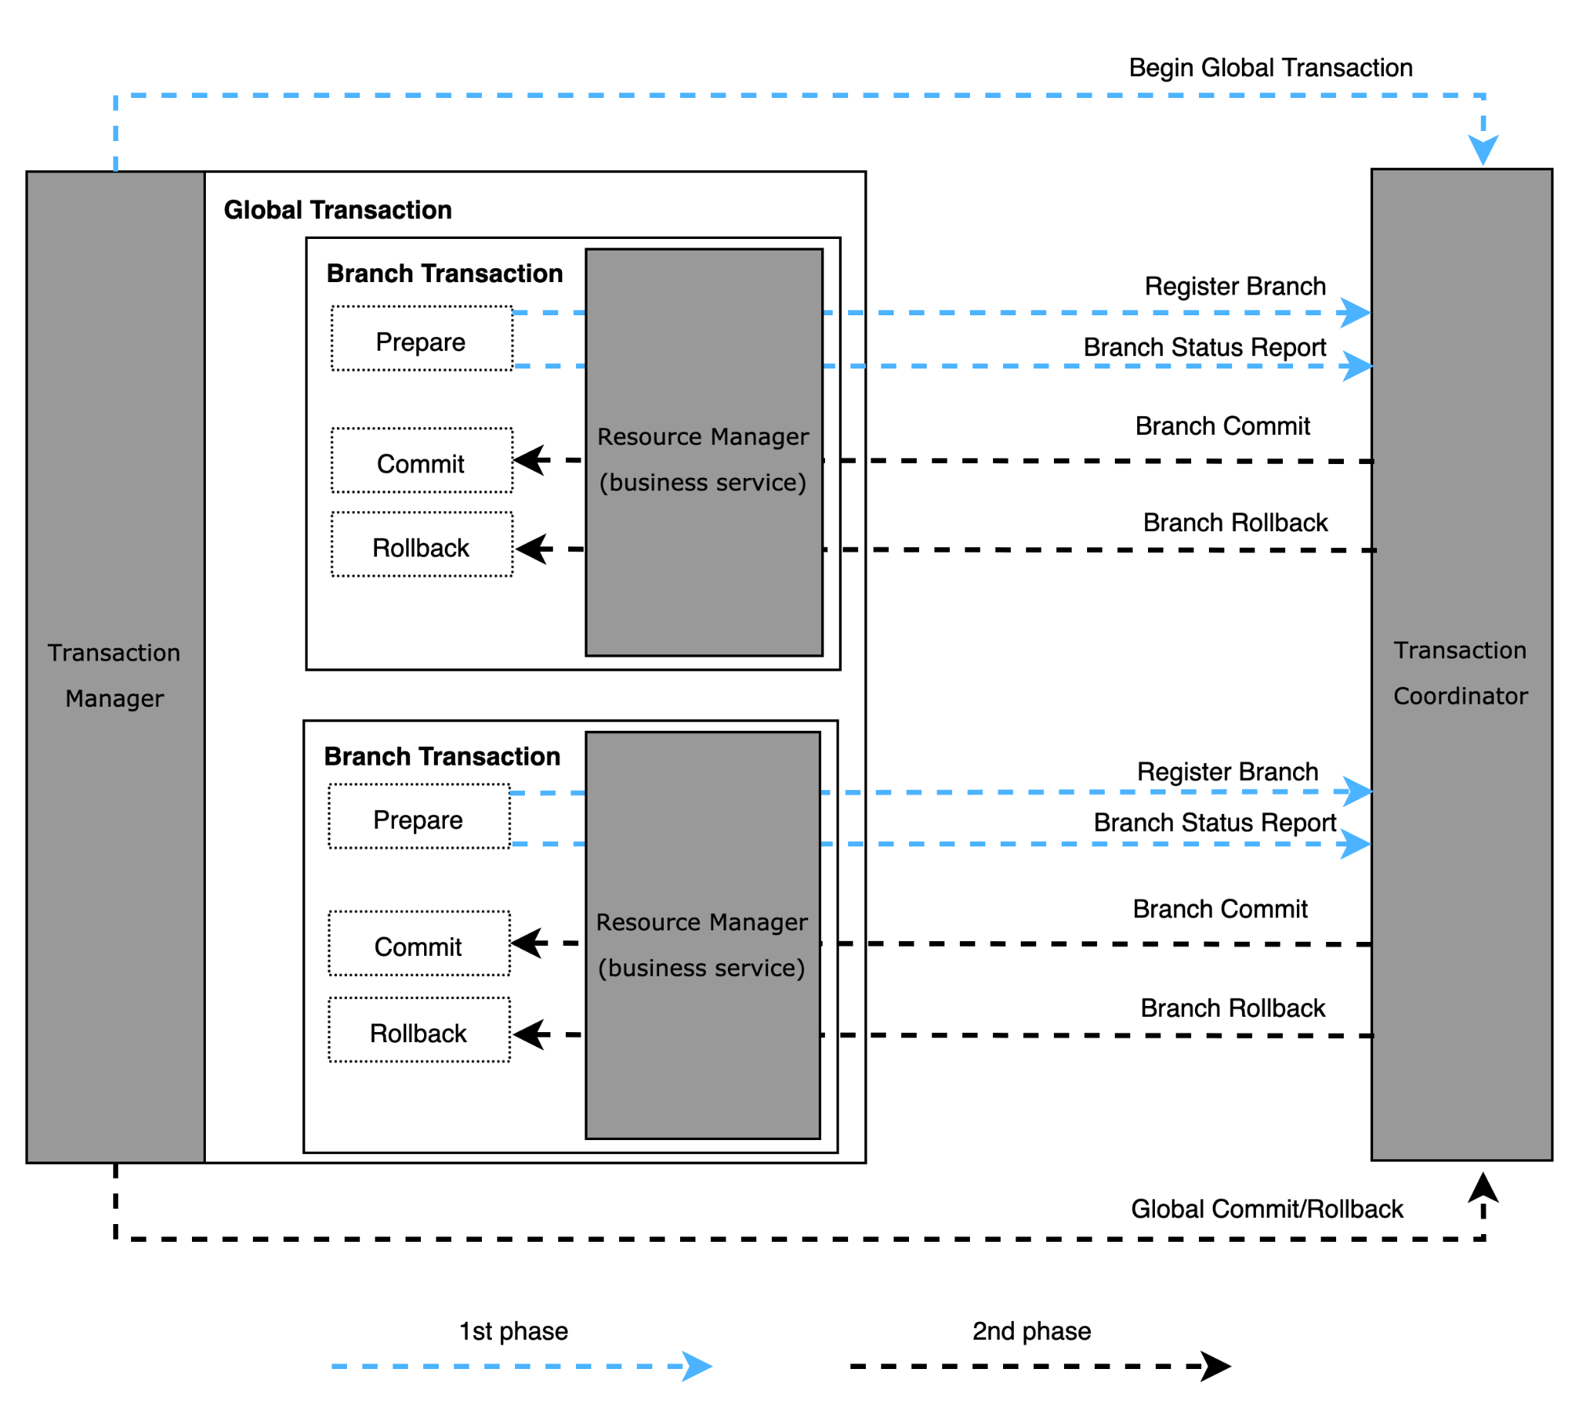

Cross database consistency risk solution selection: TCC
After comparing several distributed transaction solutions and weighing code controllability and ecological maturity, we decided to adopt Ant Group’s open source TCC solution Seata(对比几种分布式事务解决方案，权衡代码可控度、生态成熟度之后，我们决定采用蚂蚁开源的TCC解决方案Seata)。
Advantage:
Github popular
Nearly 150 companies use this solution;
The source code and documentation are complete and easy to control;
Disadvantage:
1. There are more than 10 bugs to be fixed; the code needs to be completely analyzed and repaired;
2. Code analysis and testing of abnormal scenarios are required to ensure that the functions are correct and complete;

Slide 13
Part 1: Data consistency risk prevention and control
1.Cross database consistency risk(跨库一致性风险)
2.Cross system consistency risk(跨系统一致性风险)
3.Cross datacenter consistency risk(跨机房一致性风险)

Slide 14



Cross system consistency risk(跨系统一致性风险)
01
Situation
shopee pay user
ID bank 2022.06.25 live issue
withdraw （提现）100 to bank account
shopee pay account : freeze 100
if get success resut,account -100 ;
if get fail result ,unfreeze 100;
spm
bc-db
business-center
status=fail
business-center encountered a network timeout when calling payment; however, the payment has been processed successfully，
business-center retried, payment return failed result, error code: repeated request
payment-db
payment
status=sucess
deposit
bank account balance: + 100
02
Target
Business systems are driven by RPC or messages, and data inconsistencies between systems are caused by network and other reasons; Discovering data inconsistencies between systems through technical means and providing early warning to prevent risk expansion;

Slide 15
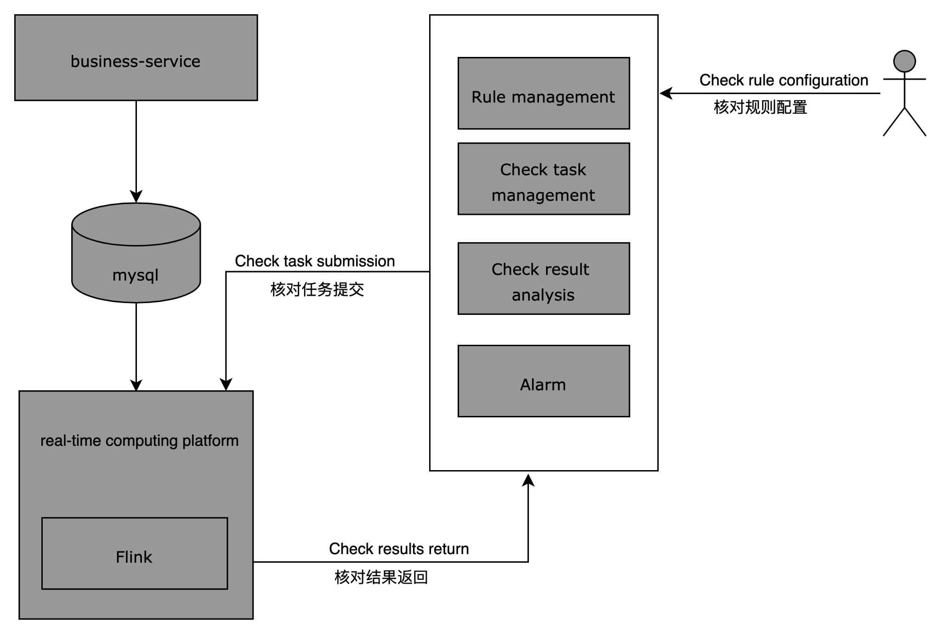
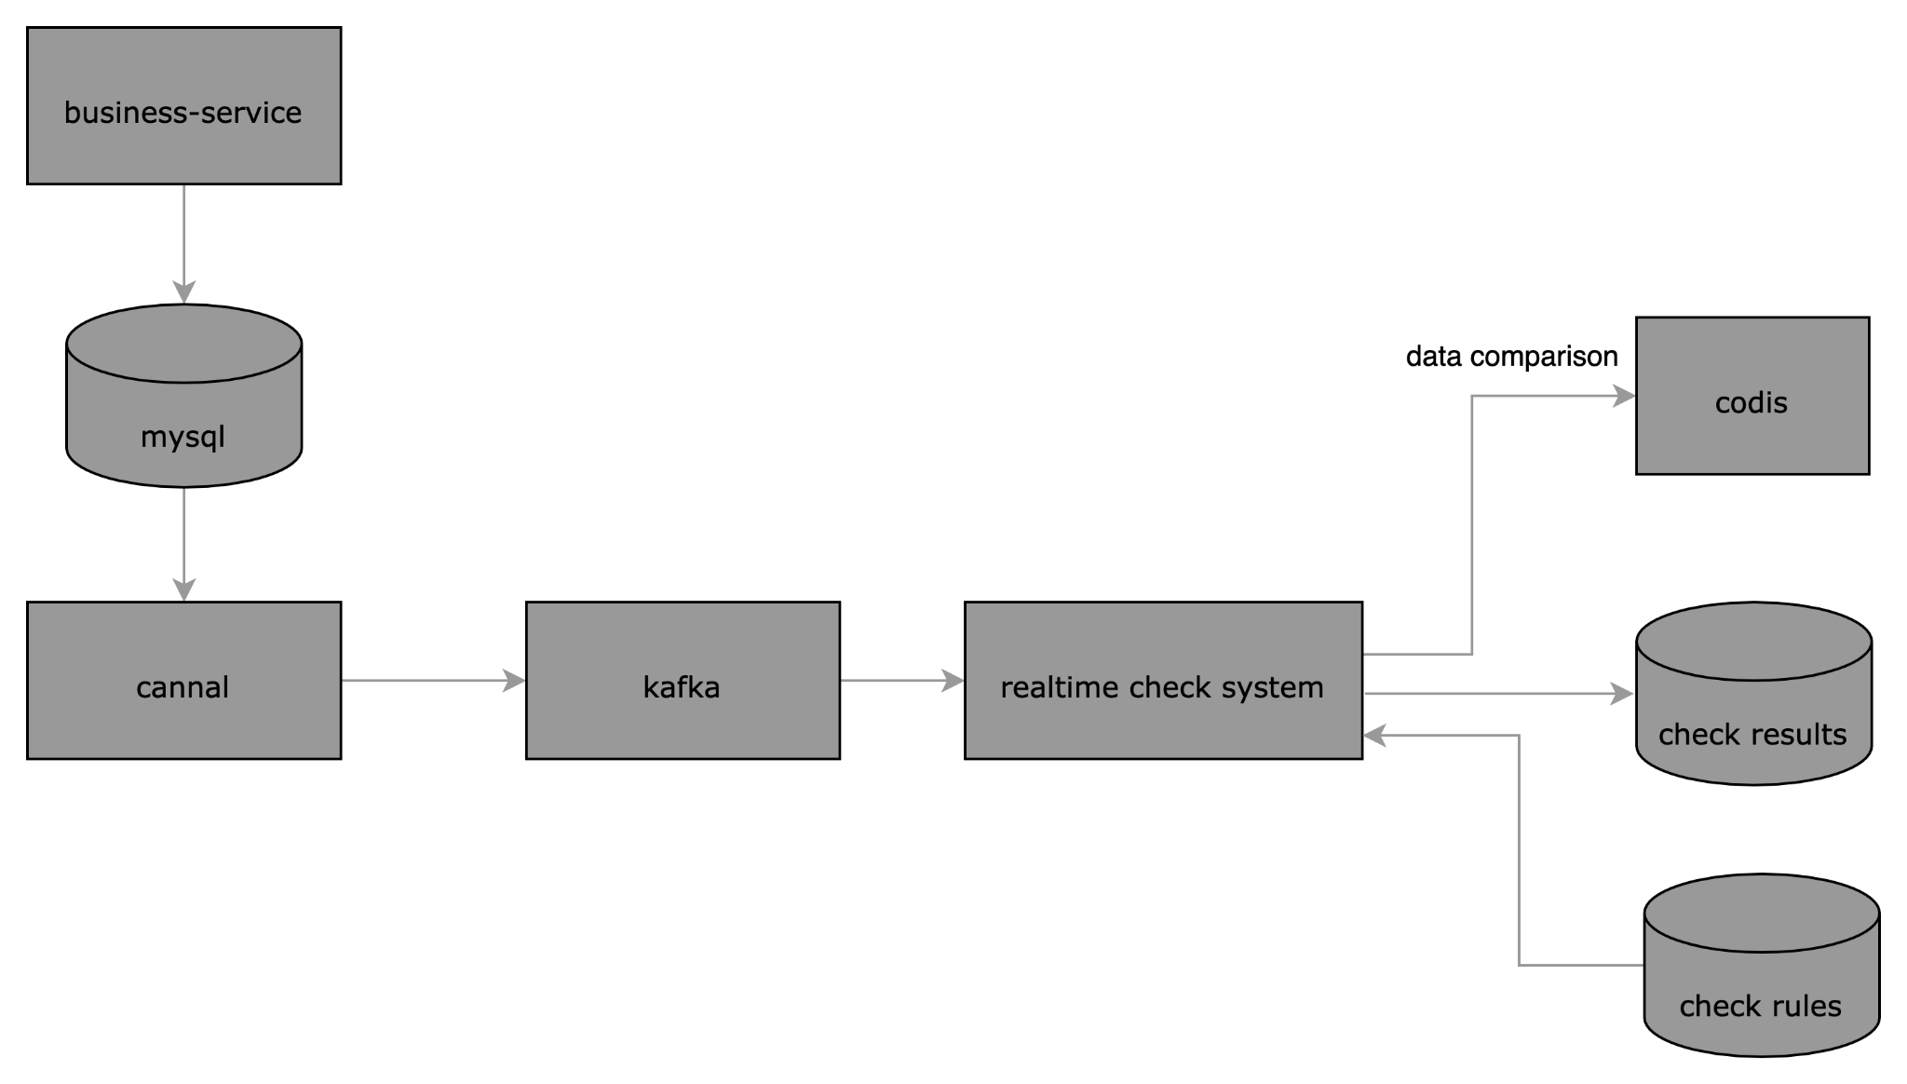
Cross system consistency risk solution compare
03
Action
Considering that the Credit real-time check system has been running stably online for more than 1 year, in order to quickly launch the real-time check system in digital banks and reduce the risk of financial loss caused by data inconsistency, our team decided to adopt the credit solution and continue to iterate based on the credit code branch(考虑到Credit实时核对系统已经在线上稳定运行1年以上，为了快速在数字银行上线实时核对系统，降低数据不一致引起的资损风险，我们团队决定采用credit的方案，并在credit代码分支基础上继续迭代)；
 | Anti Group realtime-check | Credit realtime-check
Performance | N s check complete, high throughput | N s check complete, high throughput
Development Cost | 2 人月 | 0
Technology stack | Java | Go
Ant Group real-time check system
(蚂蚁实时核对系统)
Credit real-time check system
(Credit实时核对系统)

Slide 16
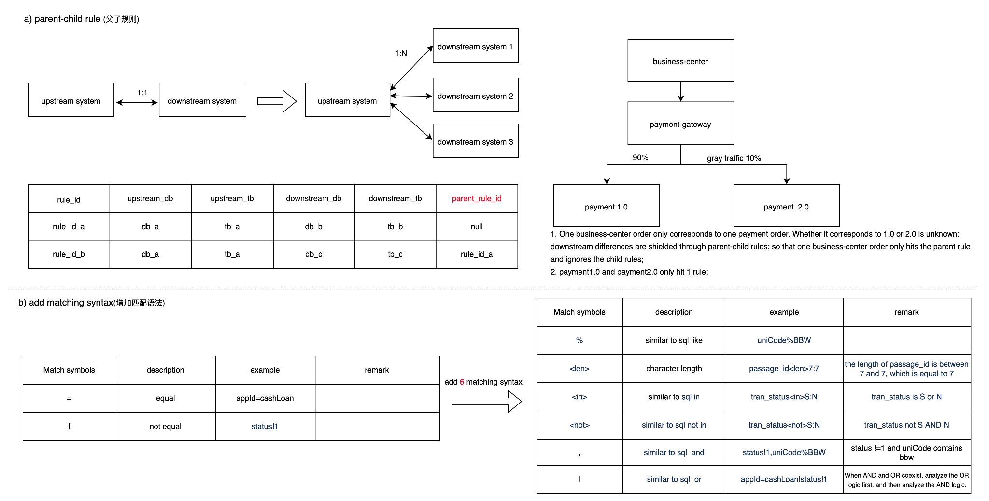
Cross system consistency risk: Expansion based credit solution

Slide 17
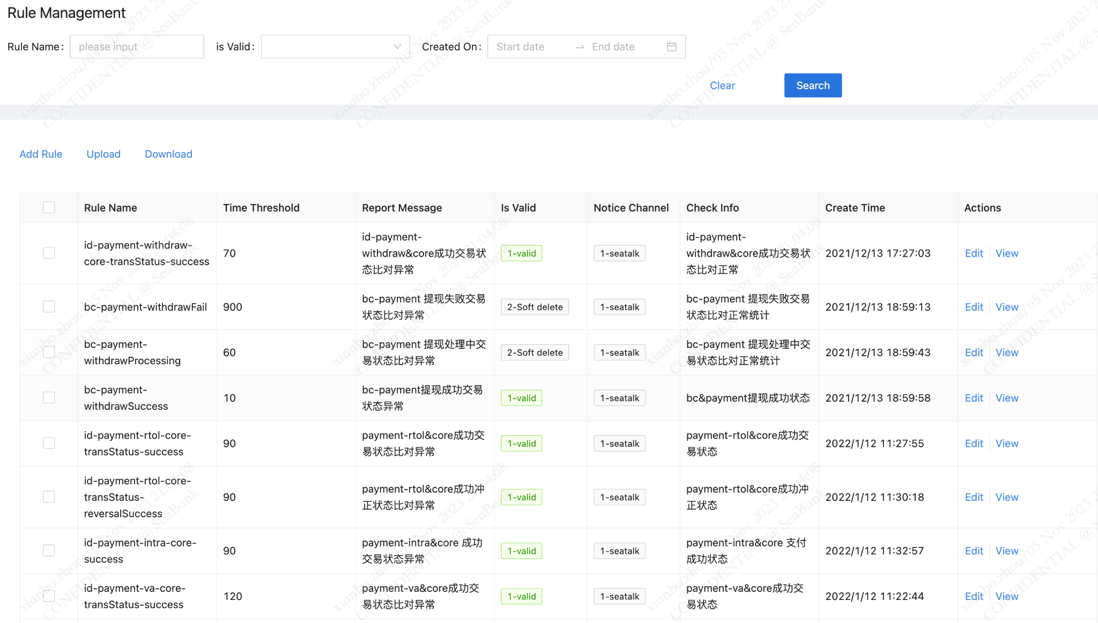
Cross system consistency risk: Configuration Console

Slide 18
Part 1: Data consistency risk prevention and control
1.Cross database consistency risk(跨库一致性风险)
2.Cross system consistency risk(跨系统一致性风险)
3.Cross datacenter consistency risk(跨机房一致性风险)

Slide 19
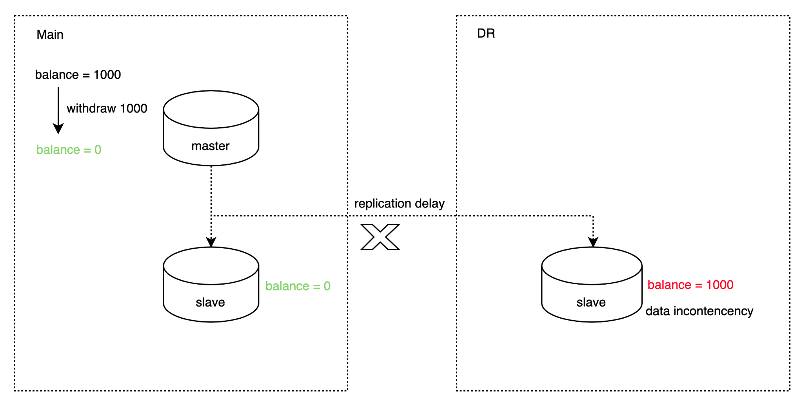
Cross datacenter consistency risk background(跨机房一致性风险)
01
Situation
MySQL database cross datacenter disaster recovery uses a semi-synchronous mechanism to replicate data; due to network delays and other reasons, MySQL cannot guarantee the data consistency between the primary node and the backup node resulting in financial loss in serious cases.
02
The mysql database uses a semi-synchronous mechanism for cross datacenter disaster recovery; there is a risk that data in transit is not synchronized to the DR datacenter; Assessing the total risk funds of account in transit(评估在途账户风险资金总额) through technical means for business decision-making, and prevent risky account transactions(阻止风险账户发起交易) ,thereby preventing financial loss;
Target
Notes:
mysql半同步复制

Slide 20
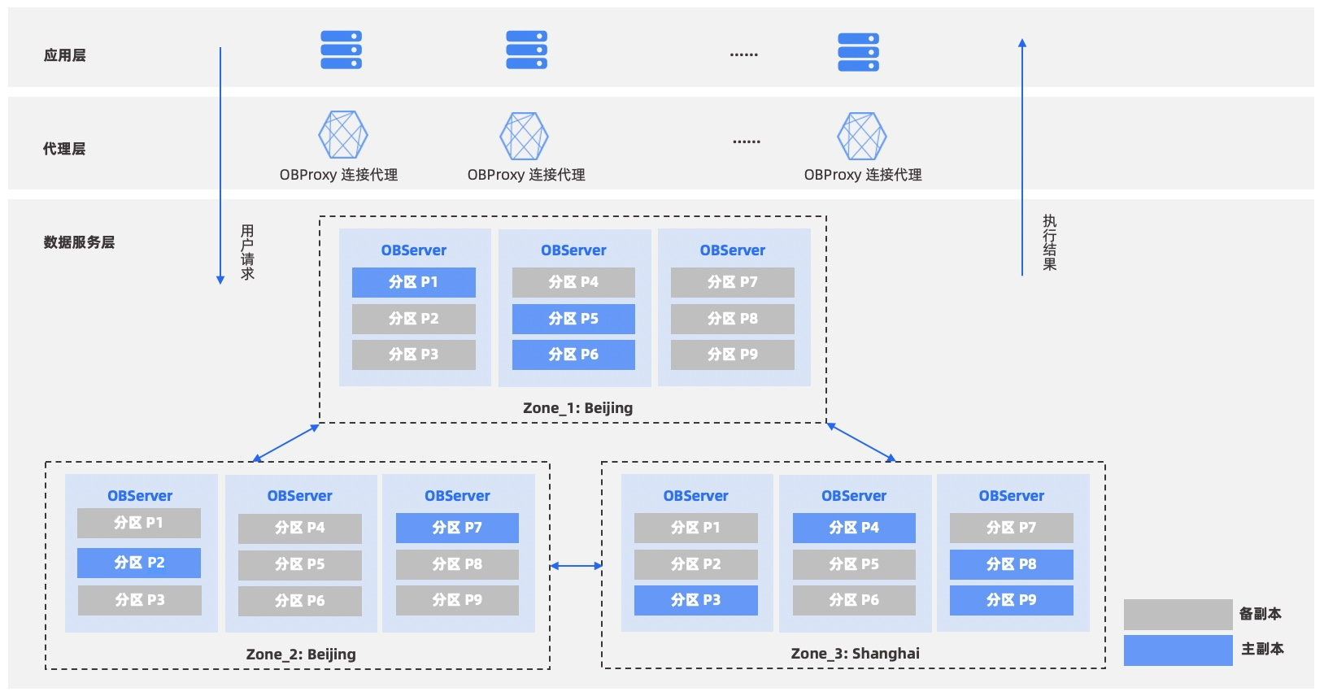
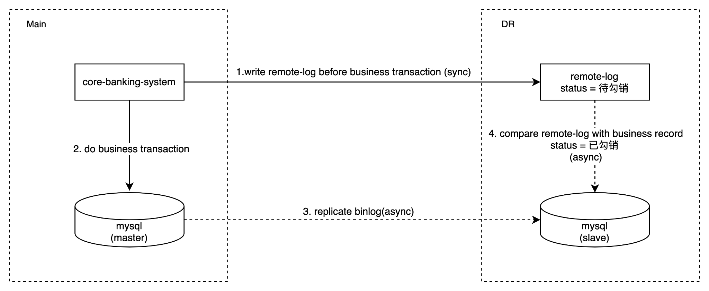
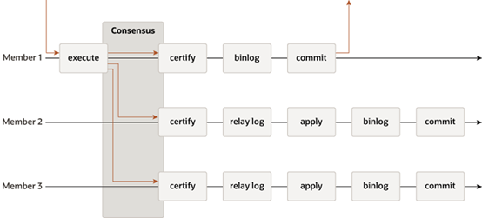
Cross datacenter consistency risk solution compare
03
Action
对比行业通用解决方案（通过数据库系统保障RPO=0），考虑技术自主可控，机房及维护成本，权衡利弊后我们决定放弃数据库多节点强一致的方案（RPO=0）；从评估业务影响范围的角度考虑，采取远程日志方案（RPO>0）。
 | mysql mgr | oceanbase | remote-log
RPO | 0 | 0 | > 0
RTO | unknow, 37unfixed bugs until Sep 2023 | 8s | 4 hours
Datacenter Cost | N/A | multi datacenter,at least 3millions $ | 3 datacenter，the 3rd datacenter low cost, $ 100 K
Maintenance Cost | N/A | high | low
Autonomous and controllable(自主可控) | N/A
Other | N/A | business competition(商业竞争) | N/A
mysql mgr（组复制）
oceanbase
remote-log
Notes:
MySQL于2016年12月发布MySQL 5.7.17推出MGR解决方案。

Slide 21
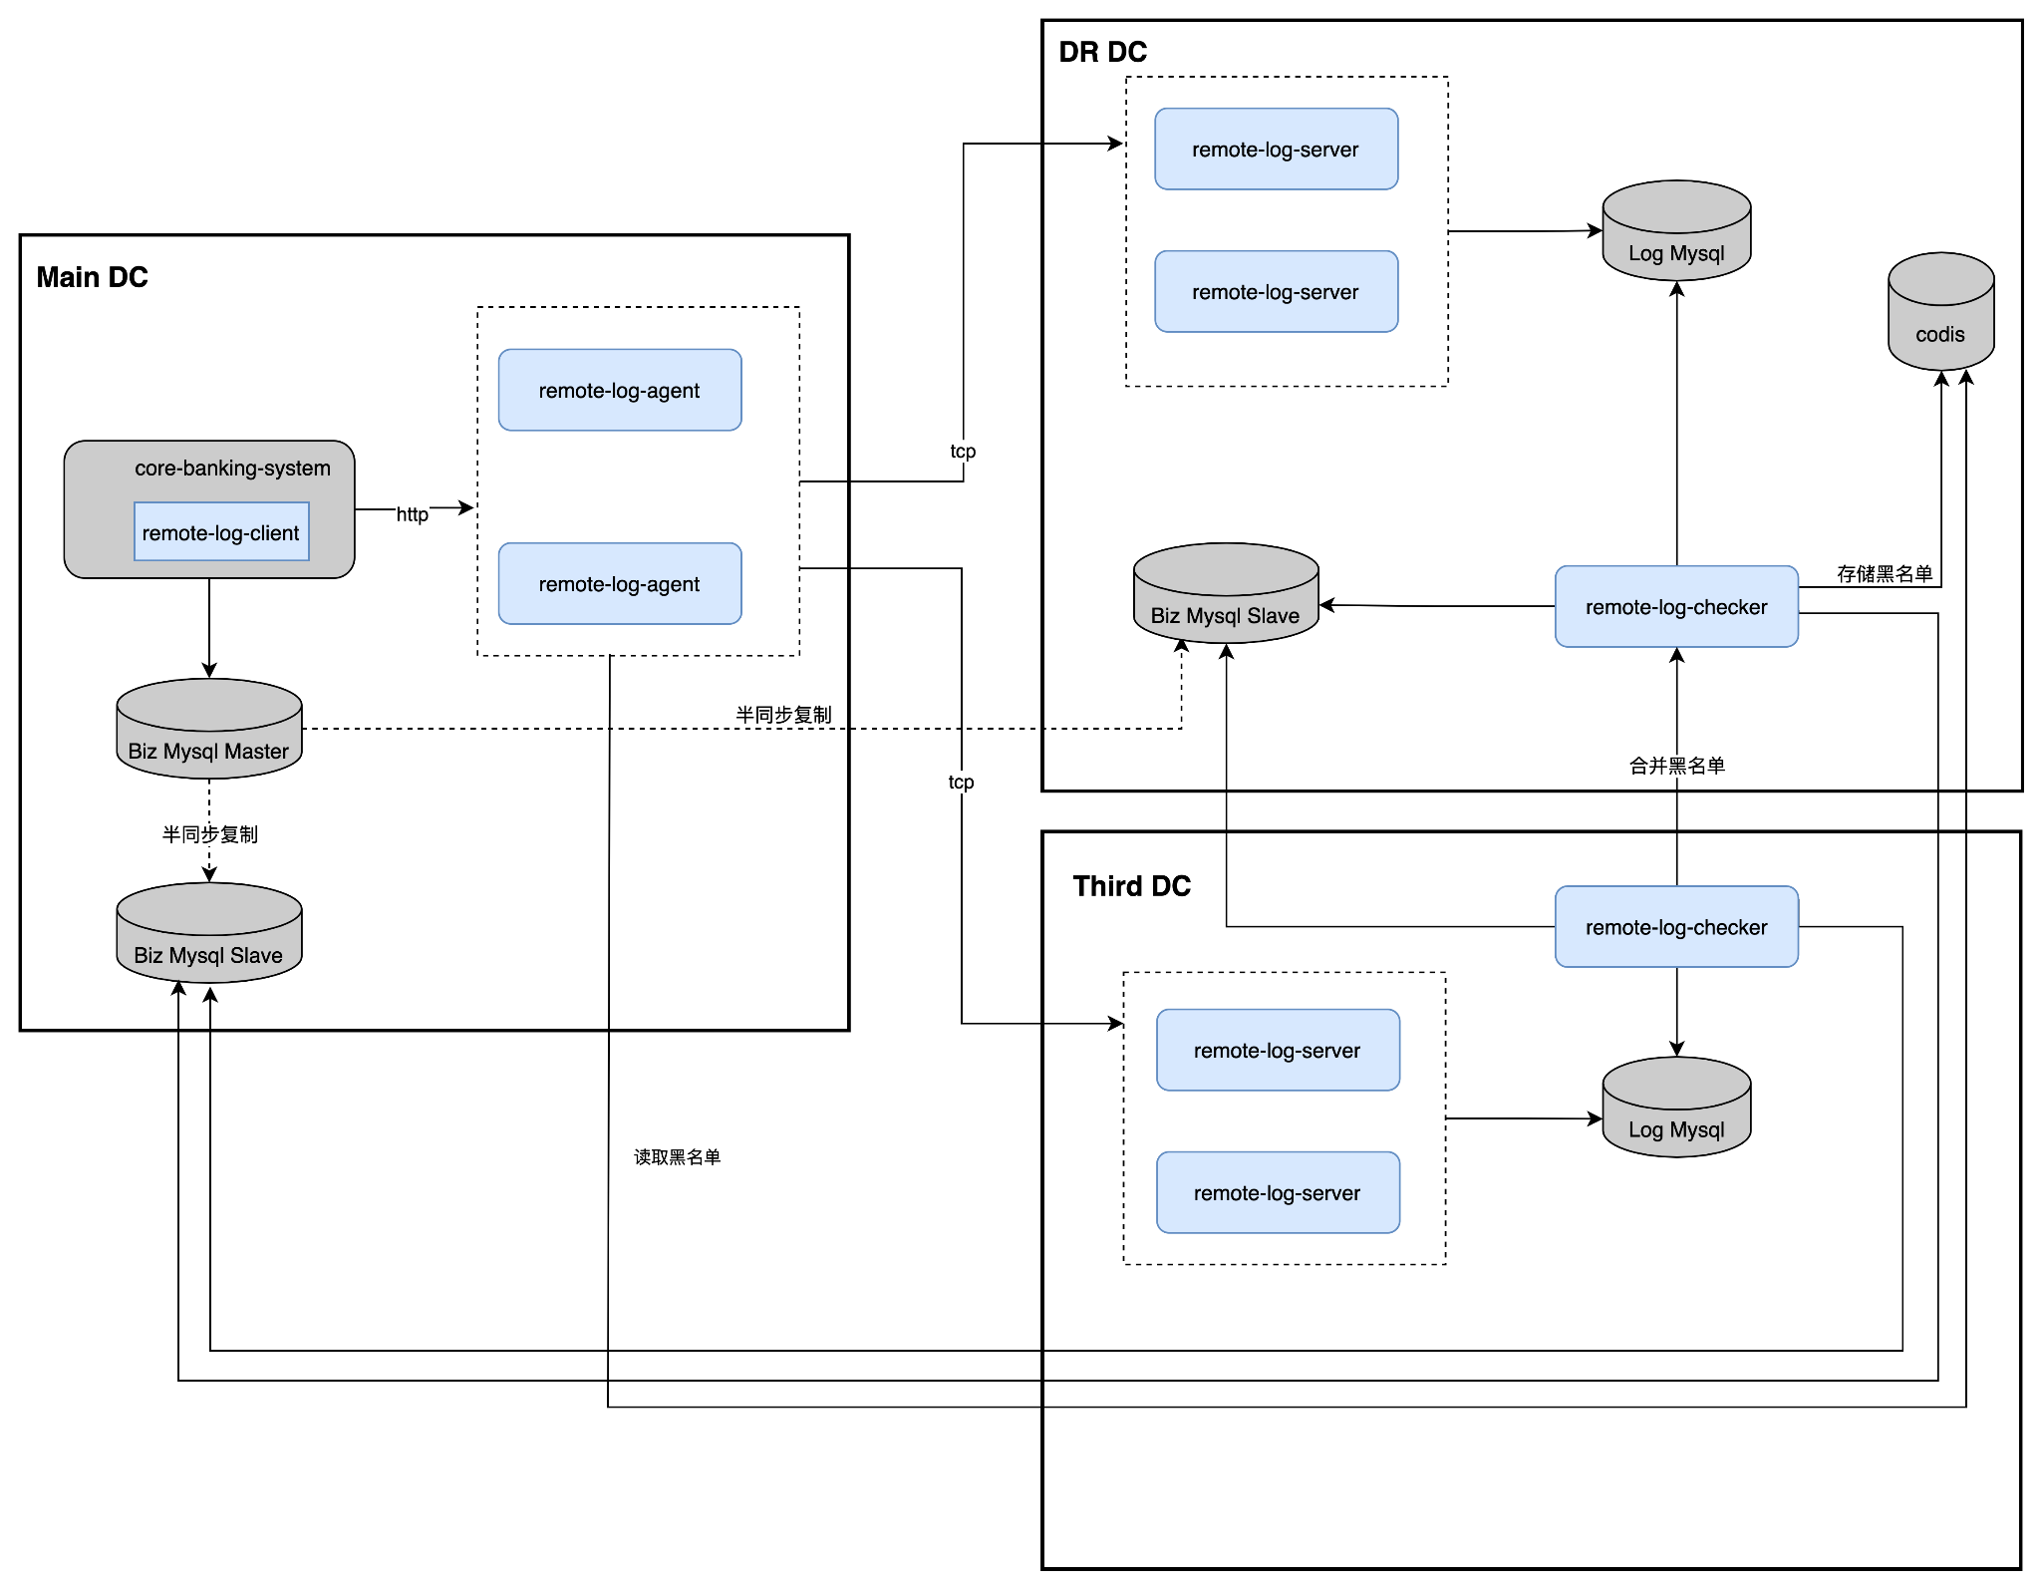
Cross datacenter consistency risk solution: remote-log
remote-log system
remote-log-client
remote-log-agent
remote-log-server
remote-log-checker

Slide 22
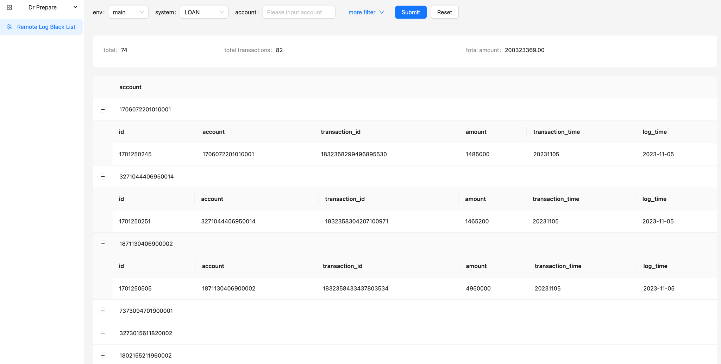
Cross datacenter consistency risk solution: console
待勾销账户总数
待勾销交易总笔数
待勾销总金额
待勾销交易明细

Slide 23
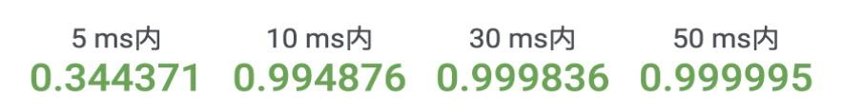
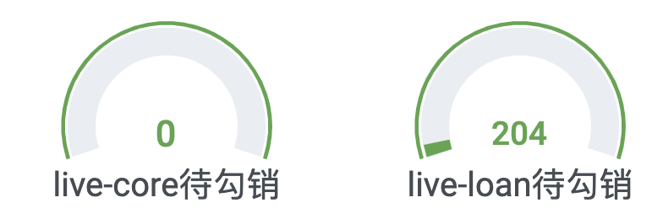
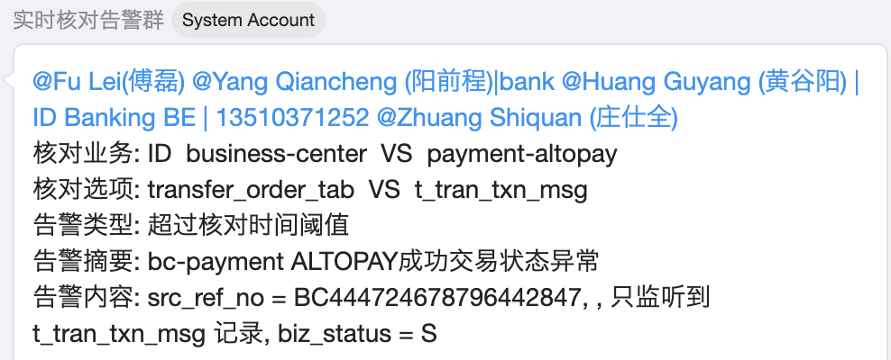
Data consistency risk prevention and control achievements
04
Result
Cross database risk prevention and control
c) Online operation status(线上运行情况)
Seata replace Saga, applied in deposit productization(在存款产品化中通过Seata取代供应商的Saga方案，解决存款核心跨库数据一致性问题)
Cross system risk prevention and control
Production application(生产应用)：2022.06.09 Real-time check alarms reveals 1 financial loss incidents and avoid further expansion of risks(实时核对告警发现资损问题，及时止损避免风险扩大)
Market Coverage(市场覆盖情况)：Covers three market fund processing scenarios of ID/PH/SG; coverage scenarios are 51/31/59 respectively; business scenarios coverage 100%；
Cross datacenter risk prevention and control:remote logs
a) Production application(生产应用)
2023/03/27 core banking database failure we assesses business impact scope through remote logs(核心银行数据库故障我们通过远程日志评估业务影响范围)
b) Market Coverage(市场覆盖情况)
ID: Deposit/Loan/Payment Acquisition/Payment Clearing/Payment Channel,5 types of businesses; synchronization mode, coverage 100%
PH: Deposit/Loan/Payment Acquisition/Payment Clearing/Payment Channel,5 types of businesses; synchronization mode, coverage 100%
SG:Investment/Payment Acquisition/Payment Settlement/Payment channel/Loan,5 types of businesses; asynchronous mode,coverage 100%

Slide 24
Data consistency risk prevention and control objectives comparison
1、Cross database consistency risk(跨库一致性风险)
The business system database is split, and the same transaction may across different databases. Using technical means to ensure cross database consistency and prevent financial loss.
Ensure cross database data consistency through the distributed transaction framework seata(通过分布式事务框架seata保障跨库数据一致性)
2、Cross system consistency risk(跨系统一致性风险)
Business systems are driven by RPC or messages, and data inconsistencies between systems are caused by network and other reasons; Discovering data inconsistencies between systems through technical means and providing early warning to prevent risk expansion；
Use real-time check to detect data inconsistencies between systems and provide early alarms（使用实时核对发现系统间数据不一致并进行预警）
Transaction logs are written to the remote log system synchronously(交易日志同步写入远程日志系统)
remote-log asynchronous reconcile; evaluate the amount of un-reconciled accounts and form a blacklist to prevent dynamic transactions of blacklisted accounts(远程日志异步勾销；评估未勾销账户金额并形成黑名单，阻止黑名单账户动账交易)
3、Cross datacenter consistency risk(跨机房一致性风险)
The mysql database uses a semi-synchronous mechanism for cross datacenter disaster recovery; there is a risk that data in transit is not synchronized to the DR datacenter; Assessing the total risk funds of account in transit through technical means for business decision-making, and prevent risky account transactions ,thereby preventing financial loss；

Slide 25
Part 2: Business continuity risk prevention and control
1.Daily development and operational risk
2.DR Switching Risk

Slide 26
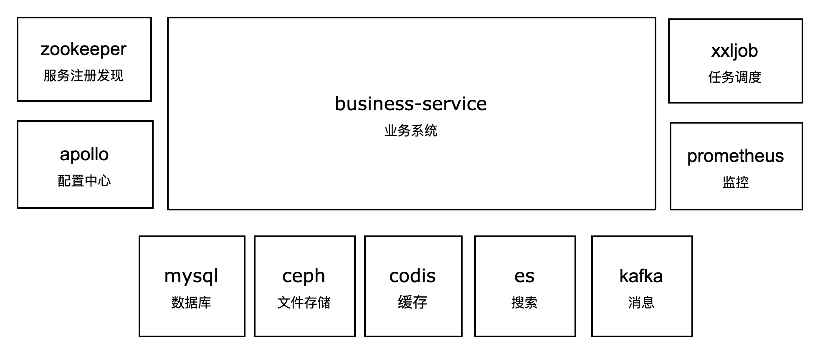
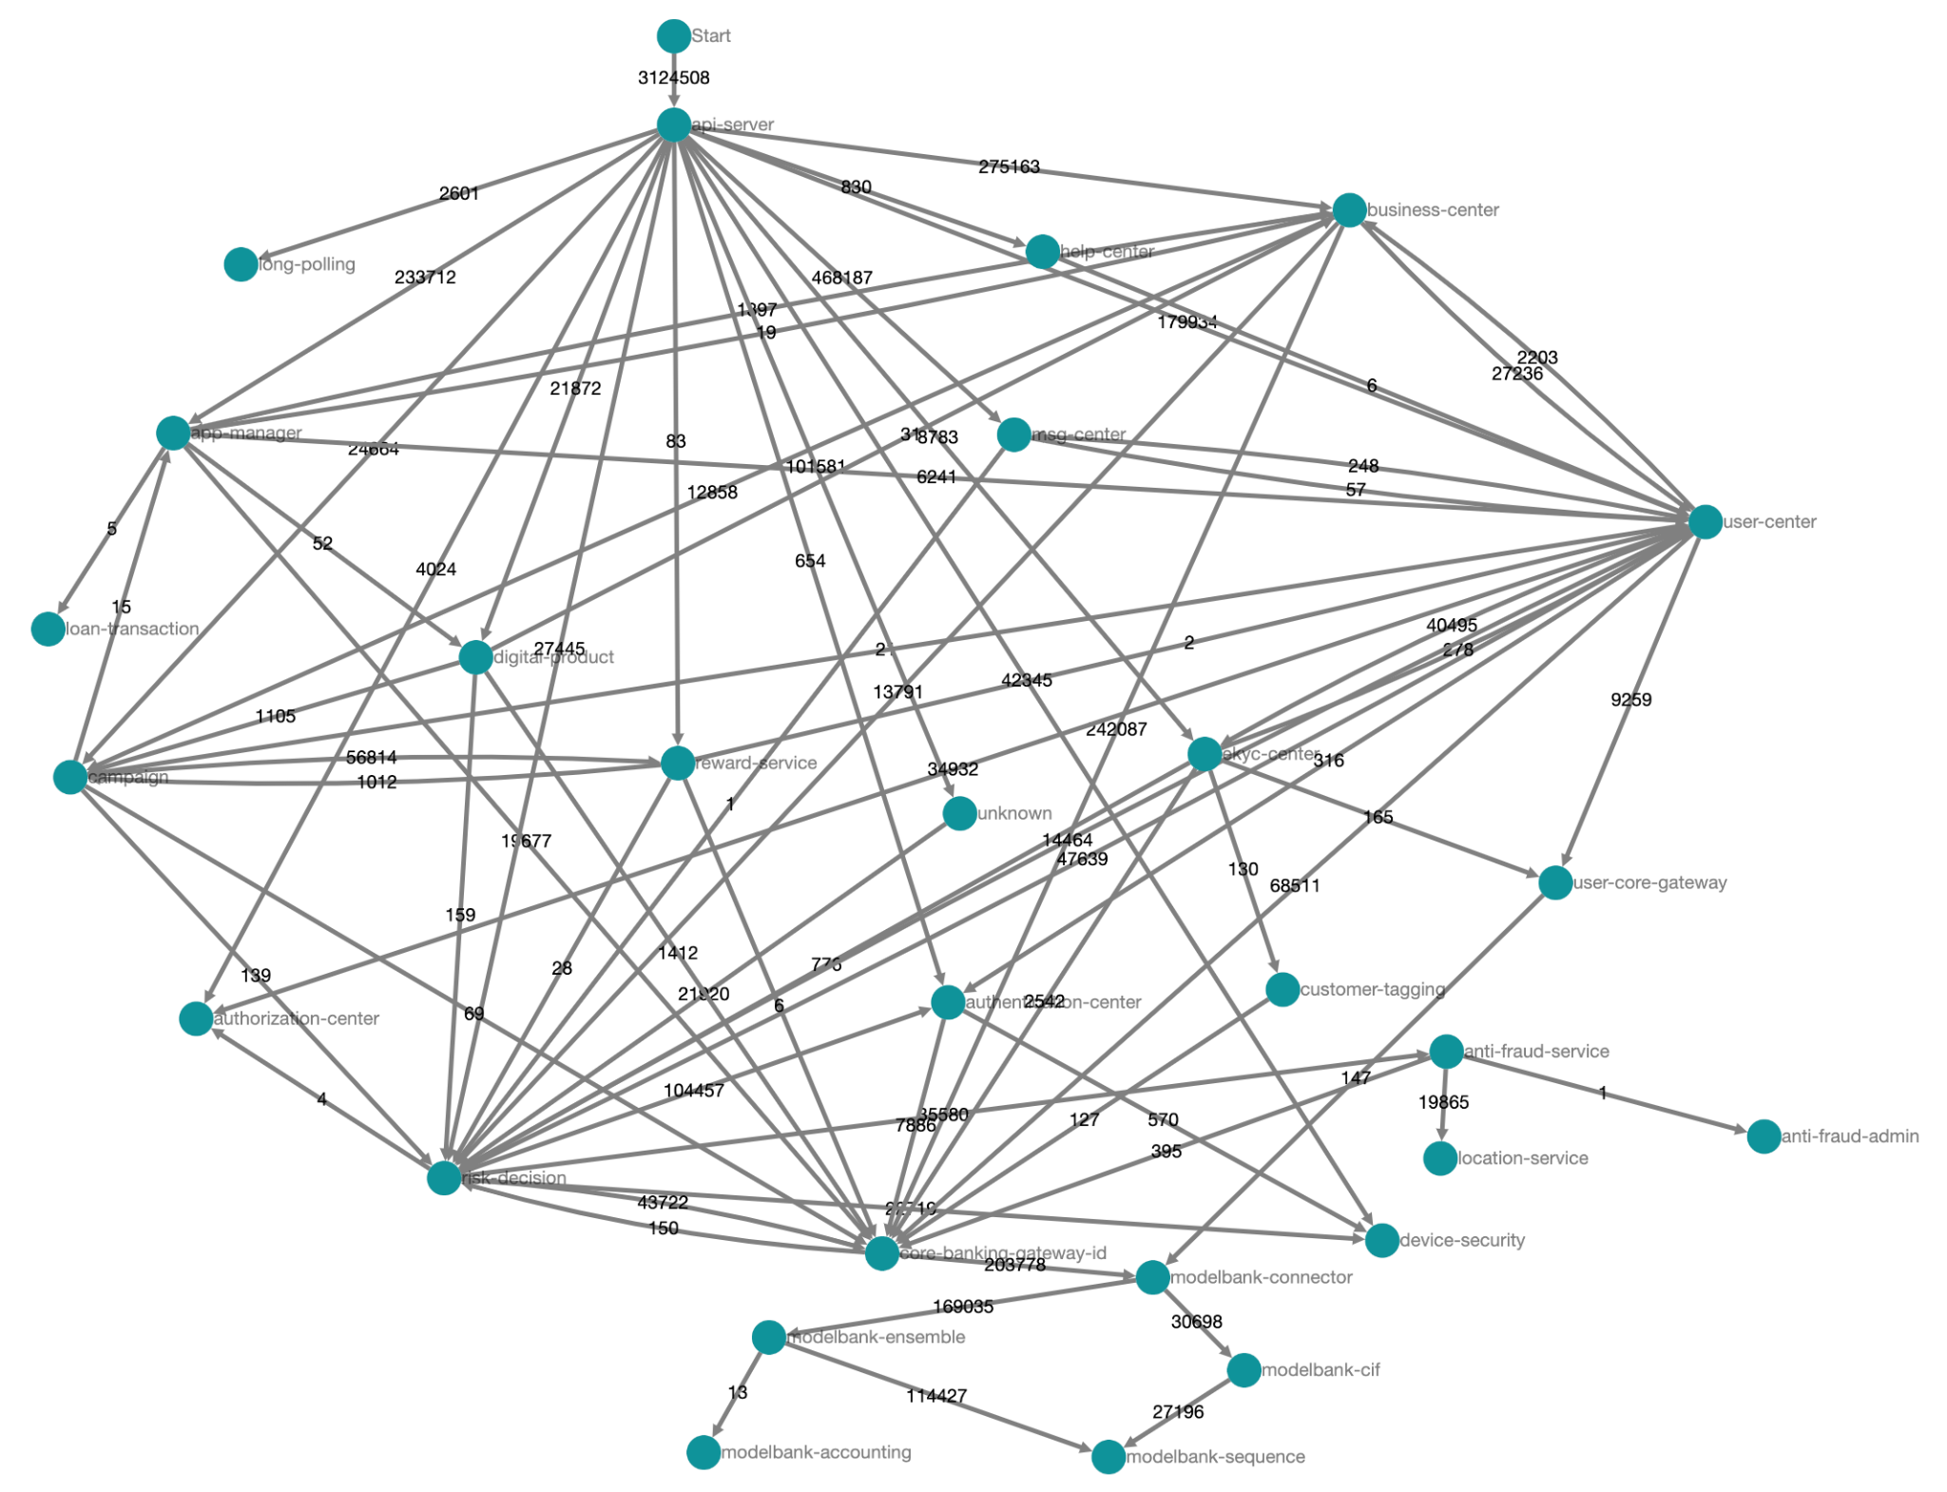
Daily development and operational risk
01
Situation
1.New technology team (more than 90% members work in the team less than 1 year in 2021), the business system is built on open source middleware, and improper use of middleware in daily development causes live issues.
many kinds of middleware clients
improper use of middleware
parameter configuration incorrect
middleware client version incompatible
[5 codis-client/kafka-client,3 zk-client,dependency conflicts]
[2021.07.01 Loan codis distributed lock connection not released, transaction fell 0]
[2021.08.30 Payment gateway OOM, payment service is unavailable]
[2022.04.22 Mobile banking zk client used a higher version of the client, resulting in data nodes stacking, which in turn affected mobile banking service discovery]
2. Daily changes cause live issues
Code change typical case: In the first half of 2021,the ID Bank system was shut down for release(停机发布); in order to reduce the impact on customers, it chose to release in the early morning;
Configuration chang typical case: 2023.06.07 PH Bank App certificate configuration change error causes the entire bank app to become unavailable
SQL change typical case: 2023.09.07ID bank payment database executes online DDL resulting in payment transaction falling to 0
3.With the rapid development of business, the number of self-developed services is growing rapidly (50+ -> 75+ self-developed services), the technical structure has gradually become complex, and there are risks in online operation(随着业务快速发展，自研服务数量快速增长（50+ ->75+），技术架构逐步复杂化，线上运行存在风险)
The service interface design is unreasonable and the app frequently times out, affecting customer use(服务接口设计不合理，具体表现为app端超时，影响客户使用)
Services grow wildly, boundaries are unclear, and dependencies between services are unreasonable(服务野蛮生长，边界不清，服务之间依赖关系不合理)
02
Target
Manage and control the dependencies and configuration of middleware through the development framework, and standardize the configuration and use of middleware during development.
Use technical means to solve service release issues and prevent and control change risks;
Monitor service interface quality and dependencies, and promote interface optimization and service governance
Prevent and control devlopment risk through development guidelines and development process inspections;

Slide 27
Daily development and operational risk solution compare
03
 | Elements(要素) | Spring Cloud | Dubbo
Effect (使用效果) | Function (功能丰富度)
 | Scalability (可扩展性)
 | Observability (可观测性)
Cost (使用成本) | Application integration costs (应用集成容易程度)
 | Maintainability (可维护性)
Ecology (生态) | Maturity (成熟程度)
 | Industry trends (业界流行情况)
Others (其他) | Team factors (团队接受容易程度)
Action
Notes:
功能丰富度：
SpringCloud: Rich in functions, in addition to basic service registration and discovery, there are also gateway components, configuration centers, etc.(功能丰富,除基础的服务注册和发现，还有方便集成的网关组件、配置中心等)
Dubbo: It focuses more on service calls of the RPC calling system and has relatively few components(比较专注于RPC调用体系的服务调用，组件相对少)
可扩展性：
SpringCloud: Based on spring, the extension points are very rich, and there are very clear extensions in multiple stages from startup to configuration loading to service invocation(基于spring体系，扩展点非常丰富，从启动到配置加载到服务调用等多个阶段都有非常清晰的扩展)
Dubbo：There are very rich extensions in the RPC calling process, and other extension points basically rely on spring(在RPC调用过程中有非常丰富的扩展，其他的扩展点基本依赖于spring体系)
可观测性：
SpringCloud：Comes with system indicator reporting(自带系统指标上报)
Dubbo：Can integrate reporting provided by spring(可以整合spring已提供的上报)
应用集成容易程度：
SpringCloud：Very low. The official provides a very convenient starter method for integrating various technical components and middleware.(非常低，官方提供了非常方便整合各个技术组件和中间件的starter方式)
Dubbo：Relatively high, you need to learn how to configure and use dubbo(相对较高，需要学习dubbo的配置方式和使用方式)
可维护性：
SpringCloud：The various usage scenarios of spring have been verified for many years, and the principles are well understood. It is relatively simple to troubleshoot http problems at the communication level(spring的各个使用场景多年来已得到验证，对原理也非常了解，通信层面要排查http的问题较简单)
Dubbo：Compared with spring, the configuration is more complicated, the RPC architecture is complex, and it is not easy to troubleshoot if you encounter problems(配置相对spring会更复杂，RPC架构复杂，如果遇到问题也不易排查)
成熟程度：
SpringCloud：Very mature(非常成熟)
Dubbo：It is relatively mature. After being donated to apache, it has undergone relatively big changes and requires users to adapt(比较成熟，捐献给apache之后产生比较大的变化，需要使用者适应)
业界流行情况：
SpringCloud：It is very popular and occupies an absolute dominant position in the domestic industry. If there are any risks or vulnerabilities, peers will respond very quickly(非常流行，在国内业界占绝对主导地位，有任何风险漏洞同行响应都非常快)
Dubbo：In recent years, its popularity in our country has dropped significantly(近几年在国内的热度有明显下降)
团队接受容易程度：
SpringCloud：Almost all BEs in Digital Banks are familiar with springboot, and most teams are using spring cloud(数字银行几乎所有BE都熟悉springboot，大部分团队正在使用spring cloud)
Dubbo：The Shenma framework uses dubbo, but the version is very old, and its usage and underlying structure are quite different from the new version(神码框架使用了dubbo，但是版本很老旧，和新版的用法和底层都有较大区别)

Slide 28
Daily development and operational risk solution selection:BCF
BCF（Banking Cloud Framework）：Function customization and capability expansion based on spring cloud
App layer
Functional architecture
Technology Architecture
bcf-web
bcf-gateway
bcf-seata
bcf-assembly
Zookeeper
http,mvc
spring-gw
TCC
assembly
tomcat,zk
bcf-filter
SAGA
web,db …
Sentinel
Dashboard
bcf-web
bcf-apollo
Apollo
monitoring
zookeeper
bcf-kafka
Kafka
Middleware layer
bcf-kafka
bcf-seq
bcf-rocketmq
bcf-es
Prometheus
bcf-
monitor
(Business)
mq-send
segment-id
mq-send
index-query
bcf-rocketmq
RocketMQ
mq-consume
snowflake-id
mq-consume
index-insert
bcf-seata
Seata
bcf-apollo
bcf-ceph
bcf-cache
bcf-dal
CAT
bcf-common
( json, money …)
config
s3
redis
mybatis
conf-encrypt
s3-encrtypt
lettuce
druid,mysql
bcf-dal-sharding
…
bcf-ceph
bcf-cache
bcf-es
Base layer
bcf-dal
bcf-common
bcf-monitor
bcf-logging
bcf-parent
json,money
cat,prometh
slf4j
dependency
CEPH
Redis
ES
MYSQL
common-api
trace
log-mask

Slide 29
Business continuity risk prevention and control result 1: BCF
04
Result
P0/P1 issues:
Easy integrate:
0 P0 incident, 4 P1 incidents, the incidents are not caused by BE Service.
04
1.1 BCF One-click integration(一键集成):
mvn archetype:generate -DarchetypeGroupId=com.shopee.bank -DarchetypeArtifactId=bank-project-archetype
-DgroupId=com.shopee.banking -DartifactId=appname -Dpackage=com.shopee.banking.appname -Dbasedir=. -DbcfGroupId=com.shopee.bankingcommonframework -DbcfVersion=2.7.2-RELEASE
 | 2021 | 2022 | 2023
ID | 0 | 0 | 2P1 (硬件故障, 前端故障)
PH | N/A | 1P1 (发布顺序) | 1P1 (业务备付金账户余额不足)
SG | N/A | N/A | 0
01
03
1.2 BCF manual integration(手工集成):
<parent>
<artifactId>bcf-parent</artifactId>
<groupId>com.shopee.bankingcommonframework</groupId>
<version>2.7.2-RELEASE</version>
</parent>
<dependency>
<groupId>com.shopee.bankingcommonframework</groupId>
<artifactId>bcf-starter-assembly</artifactId>
<version>2.7.2-RELEASE</version>
</dependency>
02
Core System availability:
ID/PH/SG bank core system availability 99.97/99.95/99.99
BCF Market Coverage(市场覆盖情况):
ID: 71/75 BCF services,1738 APIs, coverage 95%
PH: 74/74 BCF services,1019 APIs, coverage 100%
SG: 57/69 BCF services,1042 APIs, coverage 83%

Slide 30
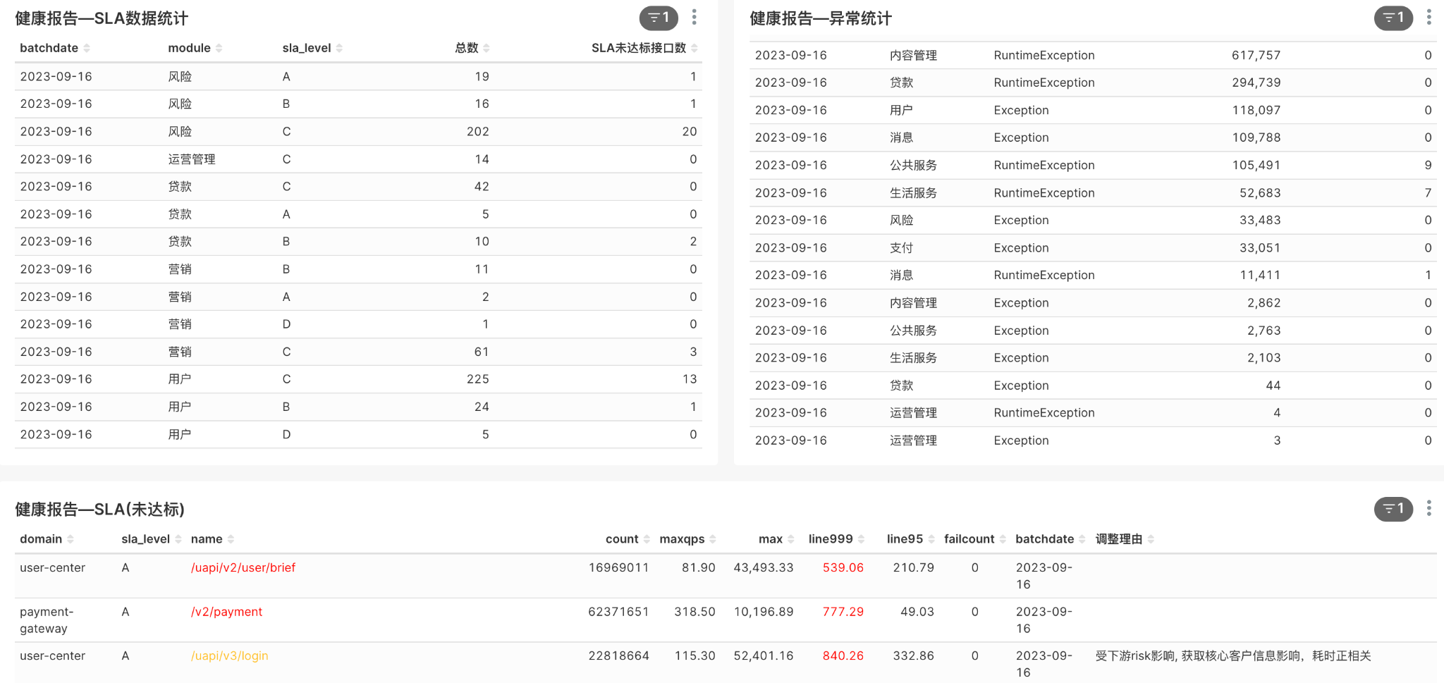
Business continuity risk prevention and control result 2:service health report
SLA未达标接口数
黑名单异常数
接口明细
接口SLA

Slide 31
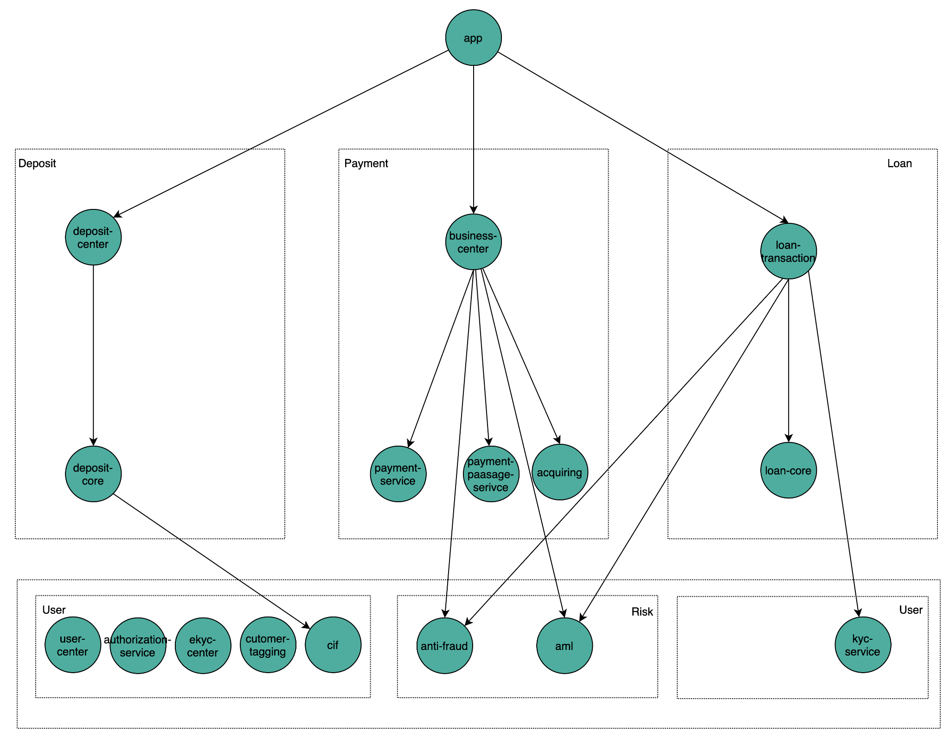
Business continuity risk prevention and control result 3:service dependency report
Promote application architecture optimization, net architecture -> vertical architecture（推动应用架构持续治理，网状架构->垂直化架构）

Slide 32
Part 2: Business continuity risk prevention and control
1.Daily development and operational risk
2.DR Switching Risk

Slide 33
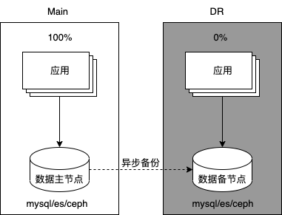
DR Switching risk background:dr switch
01
Situation
1. Regulatory requirements(监管要求)
3.Project management complexity(项目管理复杂度)
The project cycle is as long as 6 months, involving about 100+ people from 10+ teams including development/QA/SRE/3rd parties/local, etc., with a total manpower investment of about 900 people/day, including tech design, risk prevention and personnel communication in all aspects of the project process. It is a very big challenge in terms of organization and coordination(项目周期长达6个月，涉及开发/QA/SRE/三方/local等10+团队约100+人，总人力投入约900人/天，项目过程中的各环节方案设计、风险防案以及人员沟通和组织协调等方面都面临非常大的挑战).
Trials are carried out on the Disaster Recovery Plan at least 1 (one) time in 1 (one) year for all critical systems or applications according to the results of a business impact analysis and represent all critical infrastructure and involve IT users. The RTO is 4 hours，RPO is 0.
2. DR datacenter cold backup(DR机房冷备)
4. Operation and maintenance complexity(运维复杂度)
Asynchronous data backup may result in data loss, and the RPO may not meet compliance requirements(数据异步备份存在数据丢失风险，RPO可能不满足合规要求)
DR datacenter cold backup, no online traffic is running, and whether the service is available is unknown(DR机房没有运行线上流量，服务是否可用未知,RTO可能不满足合规要求);
170+ services, 20+ third-party channels, 10+ types of middleware, and 180+ databases were switched to the DR datacenter, and after completing the verification of 200+ use cases, and run it in the DR datacenter for 2 days, and then switch back to the Main datacenter(170+服务、20+个第三方渠道、10+种中间件、180+个数据库都切换到DR机房，完成200+用例的验证，然后在DR机房运行2days,最后回切Main机房);
服务数/切换时间 | 手机银行 | 核心银行 | 数仓 | 公共服务 | 第三方服务 | 服务总数 | 技术切换时间(min)
2021 | 43 | 35 | 5 | 12 | 14 | 109 | 64
2022 | 50 | 78 | 13 | 13 | 19 | 173 | 180
Number of services and DR switching time consumption of ID Bank in 2021-2022
(ID银行2021-2022年服务数量及DR切换耗时情况)
02
Target
Through tool or process optimization, ensure that DR switching does not lose data, RPO=0;
Through tool or process optimization, ensure that the DR datacenter can be switched,RTO < 4 hours;

Slide 34
DR Switching risk solution: division of responsibilities of project
03
Action
角色 | 职责
市场pic | 1、DR切换第一责任人。 2、协调资源完成技术方案落地
横向pic | 1、DR切换主要责任人，配合市场PIC完成DR切换； 2、输出整体DR切换方案和时序,DR切换技术风险分析和预案设计 3、制定DR目标文件并牵头DR项目管理 4、沉淀DR切换提效工具 5、check pic 输出的方案正确性和完整度 6、组织DR切换复盘，总结DR经验，推广各个市场。
各个模块pic | 1、根据DR切换手册指引完成对应模块的切换方案梳理。 2、根据DR切换目标文件完成对应的task。 3、确保负责模块DR切换的顺利完成。
SRE | 1、完成DR 网络重建 2、协调硬件、应用厂商、关联方的等切换运维人员 3、ops端切换方案 4、负责切换方案脚本整理
QA | 1、输出测试用例 2、负责DR 切换/回切后的内部验证 3、记录各个步骤的实际开始时间、完成时间
DBA | 1、完成数据备份 2、完成数据库切换
中间件SRE | 1、负责对应中间件切换 2、负责对应中间件数据同步一致
PM | 1、配合DR切换协调关联方停流方案
Local 业务人员 | 1、负责提供演练公告方案 2、负责流量放开前的业务验证 3、负责协调DR切换各个关联方
第三方服务支持人员(硬件、应用厂商、关联方) | 1、配合DR切换，处理DR切换中对应应用发生的问题

Slide 35
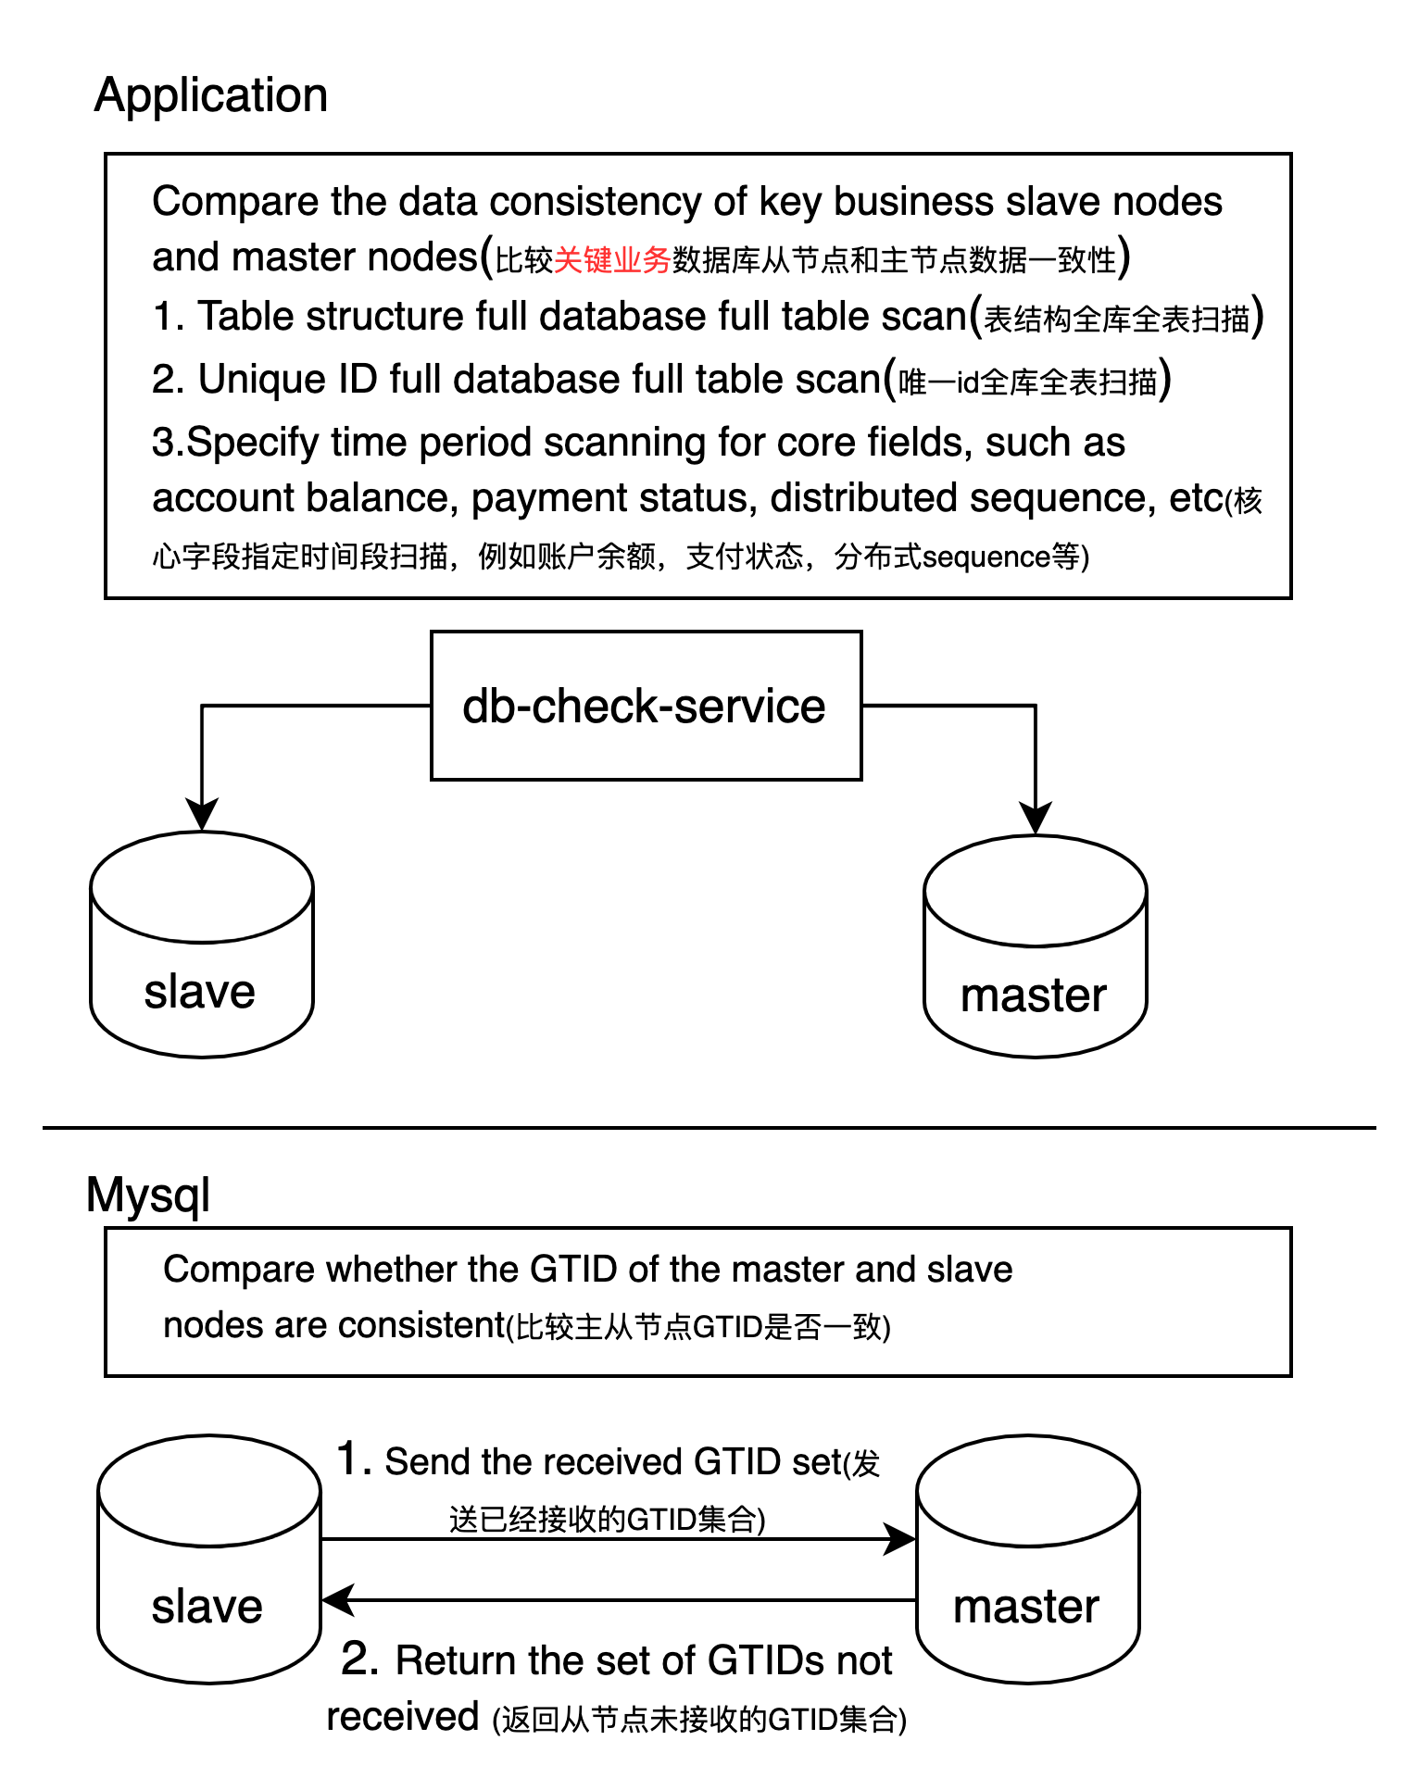
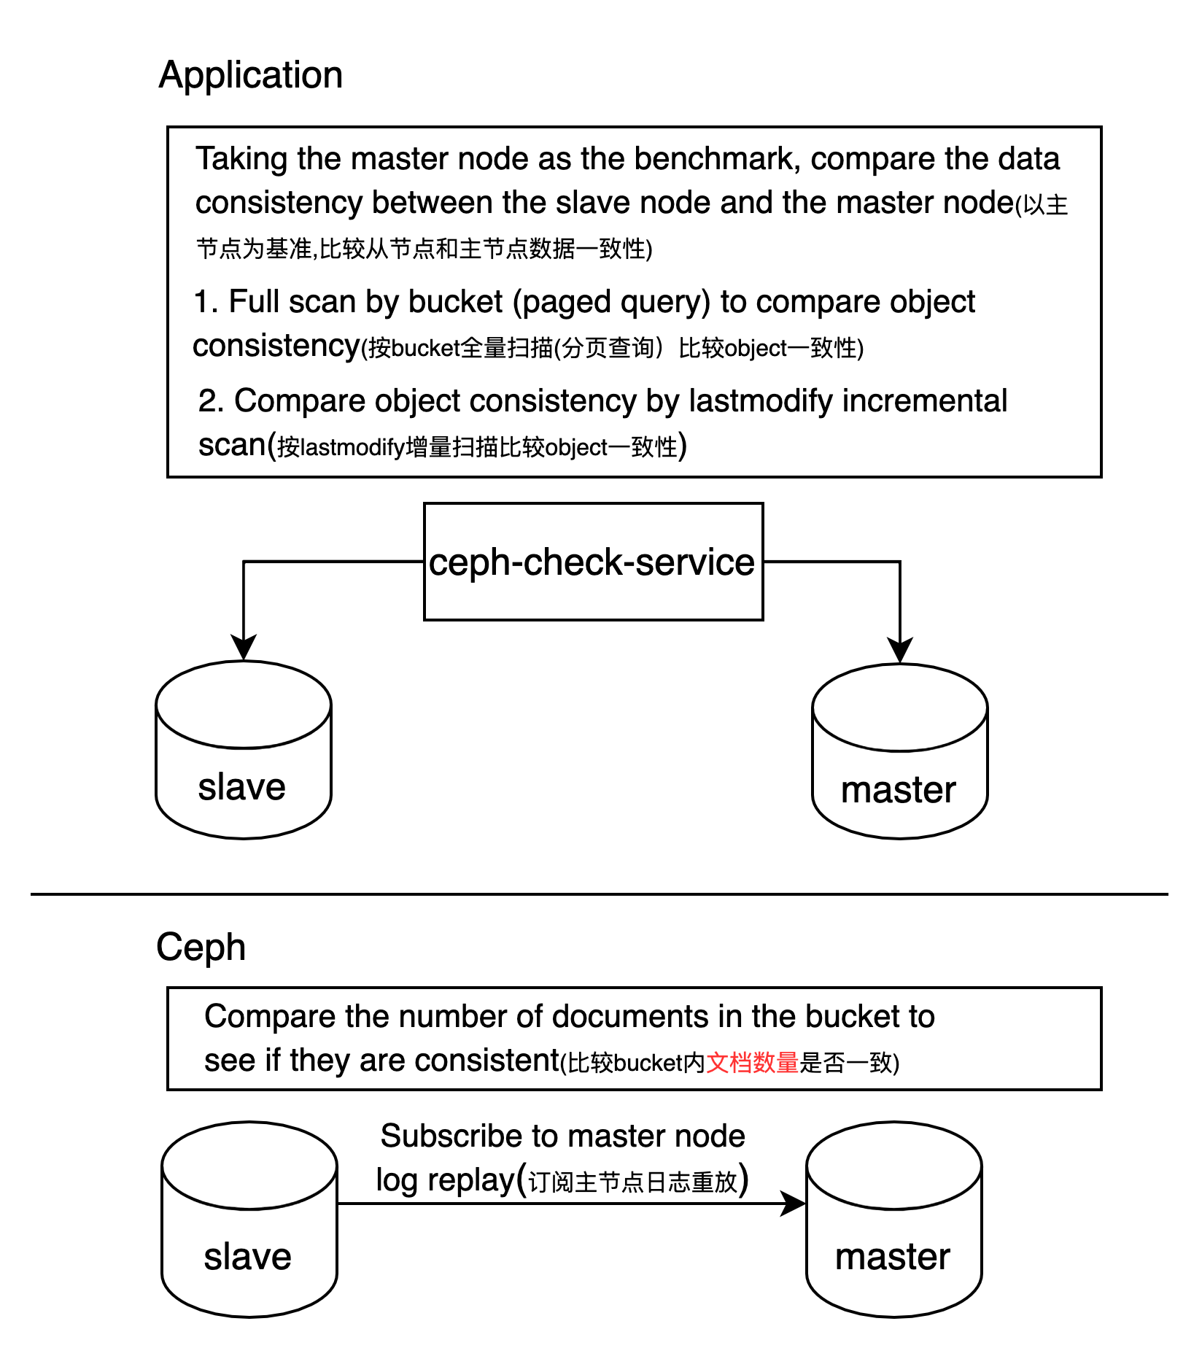
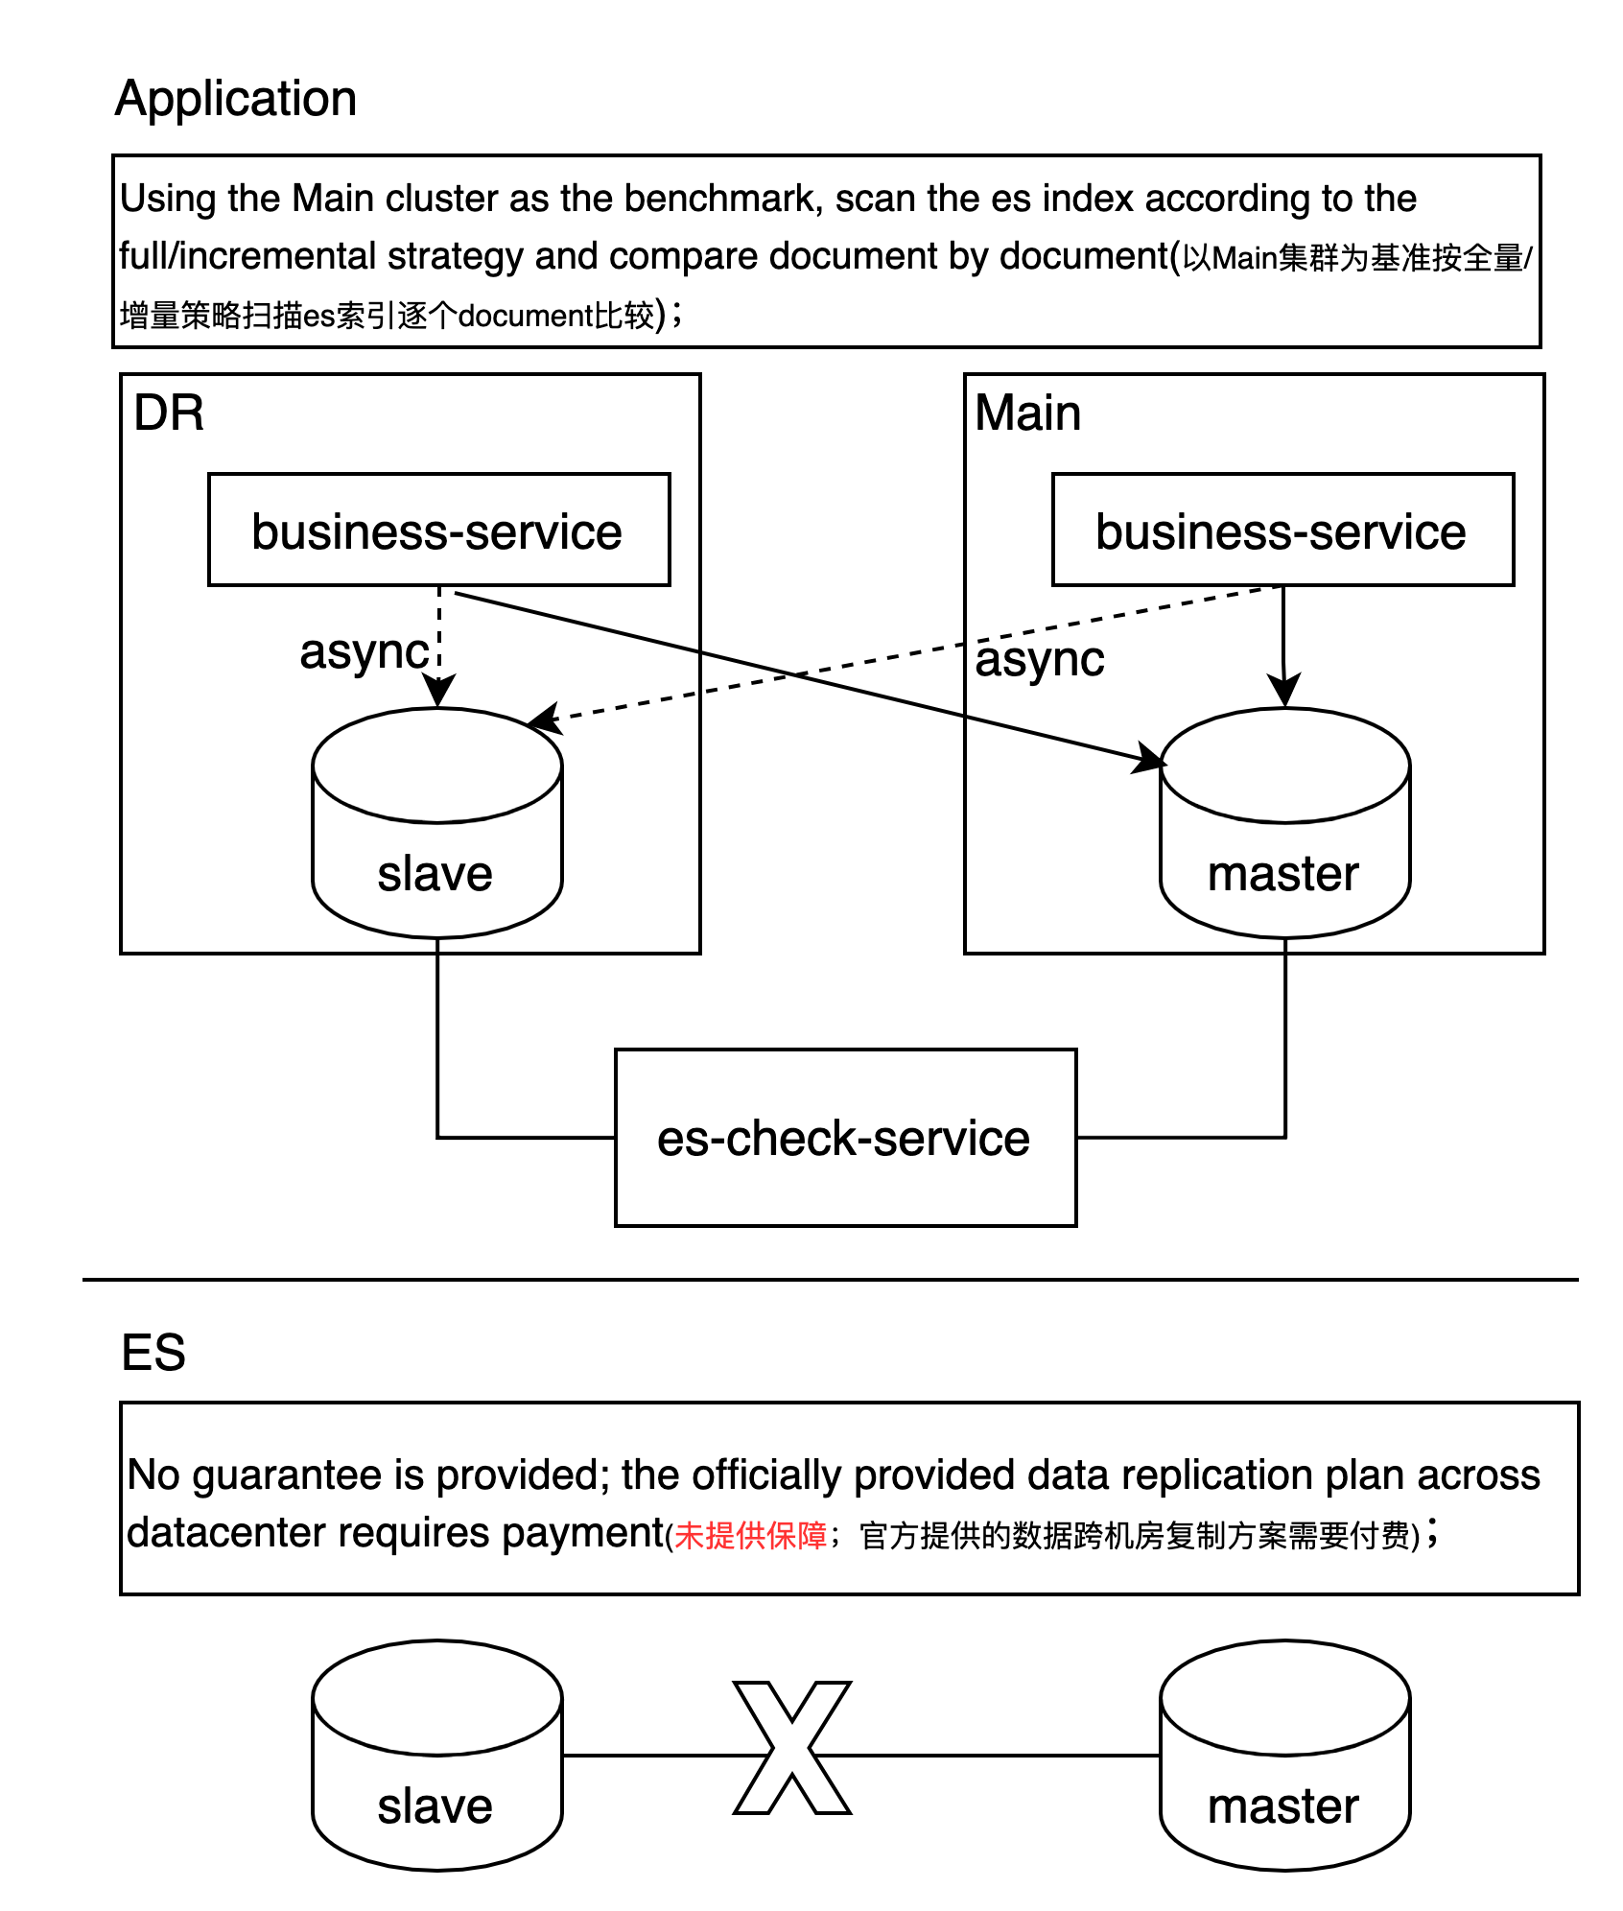
DR Switching risk solution: RPO=0
Mysql
Ceph
ES

Slide 36
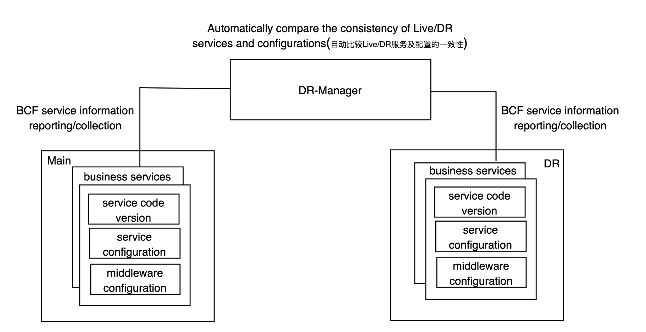
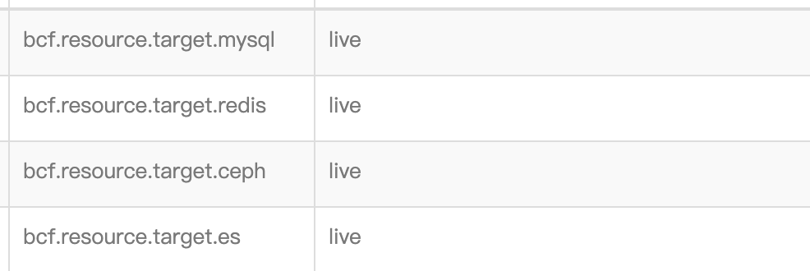
DR Switching risk solution: RTO < 4hours
1.Process guarantee (流程保障)
1
2
3
4
切换方案按模块梳理
DR nonlive演练（3轮）
DR 环境验证（3轮）
项目周会
1. 各模块PIC分别负责整理各自的方案
2. 项目组评审方案保障方案正确性
1. 验证SRE/DBA执行脚本的有效性。
2. 验证整个DR切换操作序列的配合默契程度
1. 做到100%核心业务场景的覆盖，保证DR切换前DR环境的可用性
2. 验证Local对环境和测试用例验证流程熟悉程度
1.通过周会及时跟进项目进度和风险
2. 通过周报同步信息到各干系人
2.Tool guarantee (工具保障)
Switch network connections with one click without restarting the service(连接一键切换，不重启服务)
→ dr
→ dr
→ dr
→ dr

Slide 37
DR Switching risk prevention and control results
04
Result
RPO/RTO
2023 PH DR switching(PH银行2023DR切换)
RPO: 0
Technical RTO: 1 hour and 26 minutes (objective 1.5 hours)
Compliance RTO: 2 hours and 43 minutes (objective 4 hours)
2023 ID/SG DR switching successfully achieved compliance & technical objectives(2023 DR切换顺利达成合规&技术目标)
Tool
mysql/es/ceph check service
Process
开发DR梳理模版
SRE梳理模版
QA梳理模版
第三方依赖梳理模版
DR项目管理模版
DR环境重建时序模版
DR切换checklist
DR切换时序模版
DR
Main
slave
master

Slide 38
Business continuity risk prevention and control objectives comparison
Daily development and operational risk(日常开发和运行风险)
Manage and control the dependencies and configuration of middleware through the development framework, and standardize the configuration and use of middleware during development.
Use technical means to solve service release issues and prevent and control change risks;
Monitor service interface quality and dependencies, and promote interface optimization and service governance
Prevent and control code risks through development guidelines and development process inspections;
1）Prevent daily development and online operation risks through BCF
(通过BCF防范日常开发和线上运行风险)
1.1 Middleware versions and dependencies are unified into the framework; middleware public configurations are uniformly provided by the framework(中间件版本和依赖统一到框架中；中间件公共配置由框架统一提供)；
1.2 Prevent and control code change risks through gray release and elegant start and stop(通过灰度发布、优雅启停防控代码变更风险)
1.3 Service interface quality monitoring report, service dependency monitoring report(服务接口质量监控报告, 跨领域调用监控报告)
1.4 Development guideline and process inspections：Tech Design Guideline，Coding Guideline , Code Review Guideline , Java Project Structure Guideline , Unit Test Guideline , Monitoring and Alerting Guideline, Tech Design Check , Tech Design Virtual Team,Code review
DR Switching risk(DR切换风险)
Through tool or process optimization, ensure that DR switching does not lose data, RPO=0;
Through tool or process optimization, ensure that the DR datacenter can be switched,RTO < 4 hours;
2）2023 ID/PH/SG DR switching successfully achieved compliance & technical objectives(2023 DR切换顺利达成合规&技术目标)
2.1 2023 ID DR switching(ID银行2023DR切换)
RPO: 0
Technical RTO: 1 hour and 26 minutes (objective 1.5 hours)
Compliance RTO: 2 hours and 43 minutes (objective 4 hours)
2.2 Process template accumulation
2.3 Tool accumulation: db-check-serivce, es-check-service, ceph-check-service

Slide 39
Q & A

Slide 40
Thank you

